Slide 1
EE392A
Undergraduate Research Project
Vector Search Algorithms
Supervisor: Prof. Vipul Arora
By: Sonal Agrawal
Roll no. 200995
Department of Electrical Engineering

Slide 2
Table of Content
Introduction
Previous Work
1. Product Quantization
2. Locality Sensitive Hashing
3. Hierarchical Navigable Small World
4. ScaNN
5. Scalability of algorithms discussed
6. Results and future prospects

Slide 3
Introduction
Specialized vector search algorithms for nearest neighbor search are needed because traditional search techniques can become prohibitively slow in high-dimensional spaces. In traditional search techniques such as linear search or brute-force search, each item in the dataset is compared to the query vector, which becomes increasingly computationally expensive as the dimensionality of the dataset increase

Slide 4
Previous Work
Previous works in vector search algorithms include LSH, tree-based methods, product quantization, ANN. These techniques enable efficient search for nearest neighbors and have driven progress in search engines, recommendation systems, and computer vision.
Less research has been done on graph based methods like ScaNN, HNSW.
Most analysis has been undertaken on exact match queries, I propose to give a brief analysis with perturbed queries as well and finally compare the different algorithms

Slide 5
1. Product Quantization
Product quantization is a popular method for approximating vector quantization in high-dimensional space.
This algorithm allows us to represent high-dimensional data in a compressed form, reducing storage requirements and computation time.

Slide 6

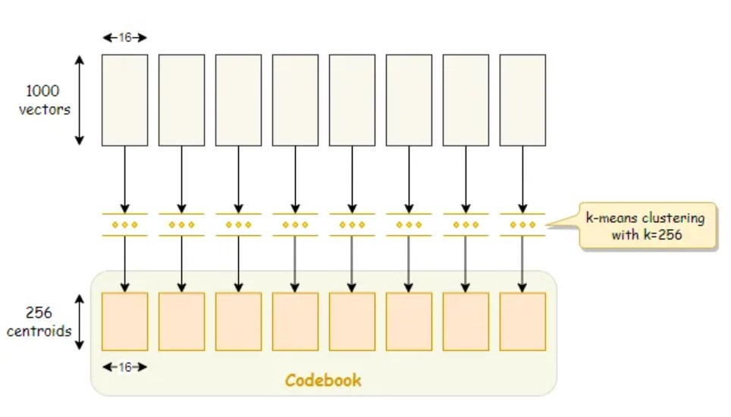
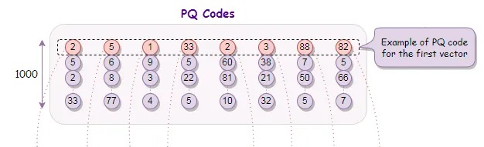
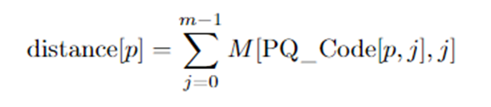
ENCODING
QUERY SEARCH
QUANTIZATION
Vectors are divided into ‘M’ chunks, called sub-vectors.
k-means clustering applied on each set of sub-vectors to find ‘k’ centroids, C_{j,k}.
A Codebook of size ‘k’ x ‘m containing all centroids is generated..
Each vector is represented through encoding formed by the closest centroid of every chunk. This is stored in a matrix called PQ_Code.
L2 norm used as the distance metric.
Divide the query vector into ‘m’ chunks and create a distance table using Squared Euclidean distance
Calculate the distance of the query vector from each vector by summing the partial distances according to the PQ_Code.
Sort distances and return top K neighbours

Slide 7
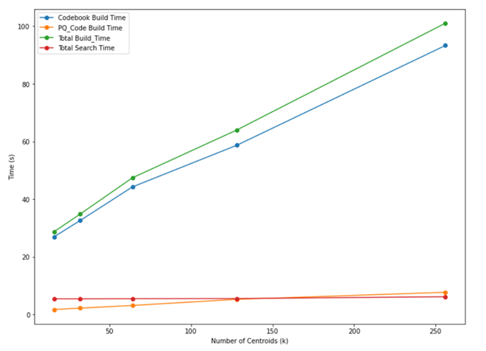
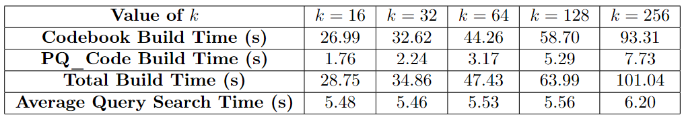
Query- exact matches
Parameters that affect time/memory
k : The number of codewords or centroids in each codebook
M : The number of subvectors into which a high-dimensional vector is partitioned
Initially, M=8, k=[16,32,64,128,256]
Accuracy of search is 1 for all cases.

Slide 8
For perturbed query (Gaussian Noise, sigma=0.1)
Value of k (M=4)` | k=16 | k=32 | k=64 | k=128 | k=256
Codebook Build time(s) | 22.960 | 27.059 | 35.706 | 50.436 | 82.629
PQ_Code Build time(s) | 1.633 | 2.097 | 2.492 | 4.862 | 6.805
Total Build time(s) | 24.593 | 29.156 | 38.198 | 55.298 | 89.434
Average Query Search Time(s) | 3.906 | 3.906 | 3.932 | 3.955 | 3.936
Accuracy | 0.1 | 0.2 | 0.6 | 1 | 1

Slide 9
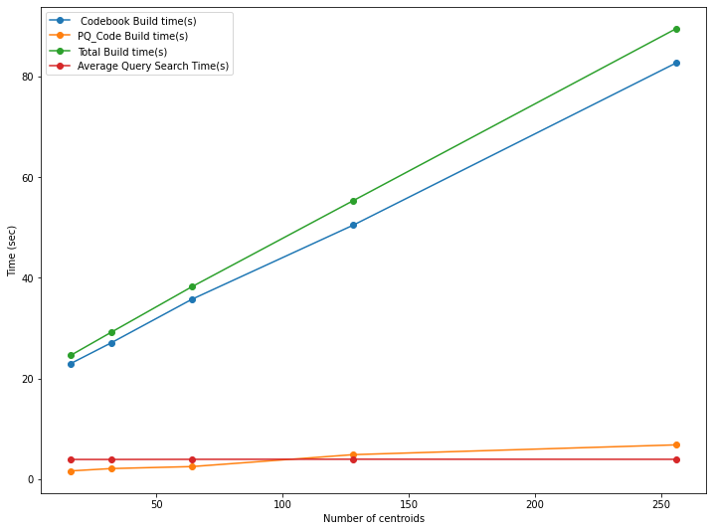
Inferences made from the graphs
With increase in ‘k’, the Building Time of Codebook increased linearly.
The Building Time of PQ_Code also increases linearly
Total Search Time is almost constant because ‘k’ does not play a major role in it.

Slide 10
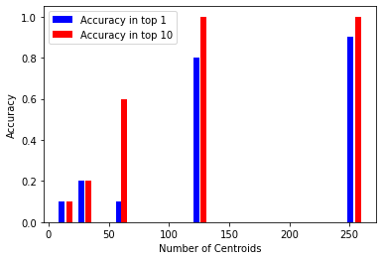
Accuracy for perturbed query increases with increase in k

Slide 11
2. Locality Sensitive Hashing
It is a family of hash functions that maps high-dimensional vectors to binary codes such that the probability of collision between the codes is higher for vectors that are close to each other in the original space.
It comprises mainly of three methods : shingling, min-hashing, searching.

Slide 12
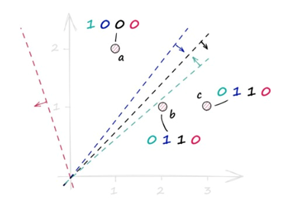
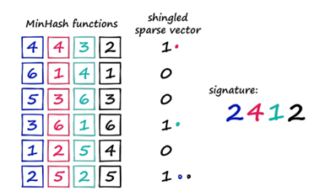
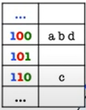
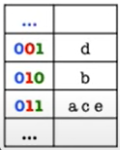
MIN-HASHING
QUERY SEARCH
SHINGLING
Converting d-dimensional data to k-dimensional 1-hot encoding
Random Hyperplanes are chosen and the sign of the dot product with the vector is considered.
If the sign is positive, then that hyperplane receives a 1, otherwise it receives a 0.
Reduce dimension of data from k to ~20 depending on vector shape.
Not compulsory
Create L hash tables, with k hyperplanes each. Bucket vectors with same code in one row
Query vector is hashed similarly
Similarity is judged on the Jaccard score
Each vector in the final bucket is individually matched through the chosen distance metric.
Table 1
Table L
k hyperplanes per hash table

Slide 13
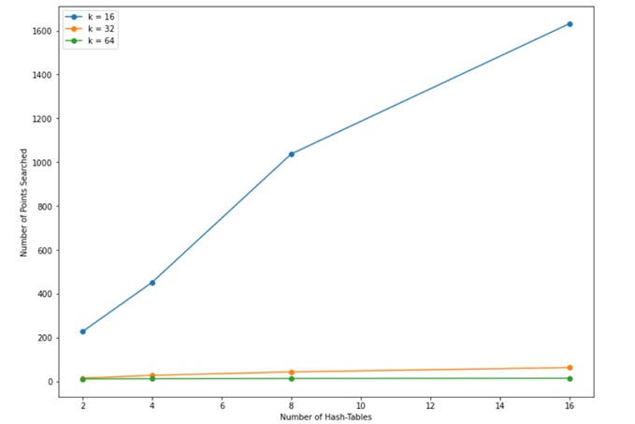
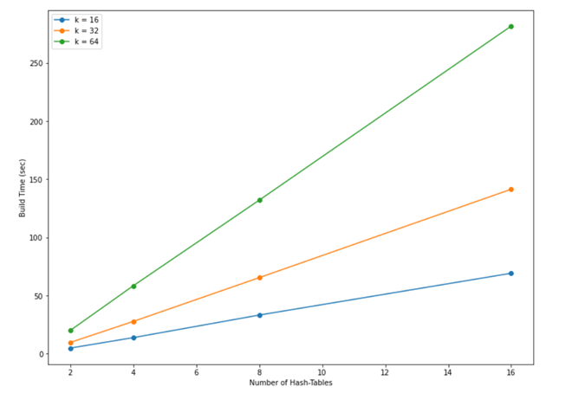
Parameters that affect time/memory
Exact match query
No. of Points Searched vs Number of Hash Tables
Build time vs Number of Hash Tables

Slide 14
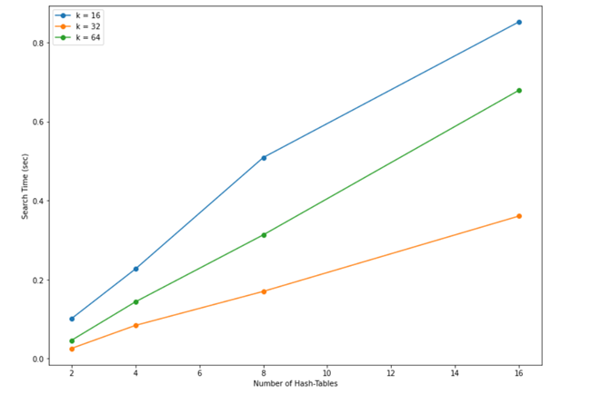
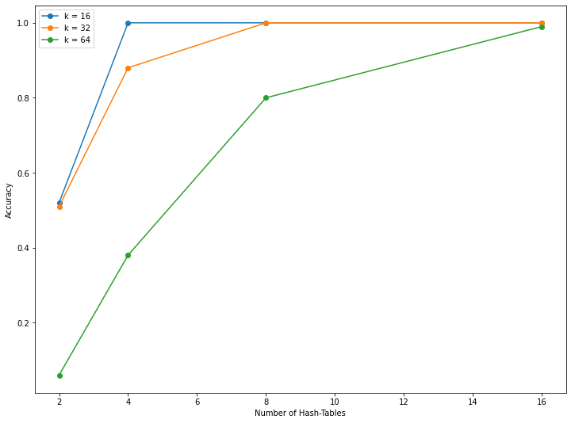
Search time vs Number of Hash Tables
Accuracy vs Number of Hash Tables
Parameter | Number of Points Searched | Build Time | Search Time | Accuracy
k ↑ | Decreases | Increases | Decreases | Decreases
L ↑ | Increases | Increases linearly | Increases | Increases

Slide 15
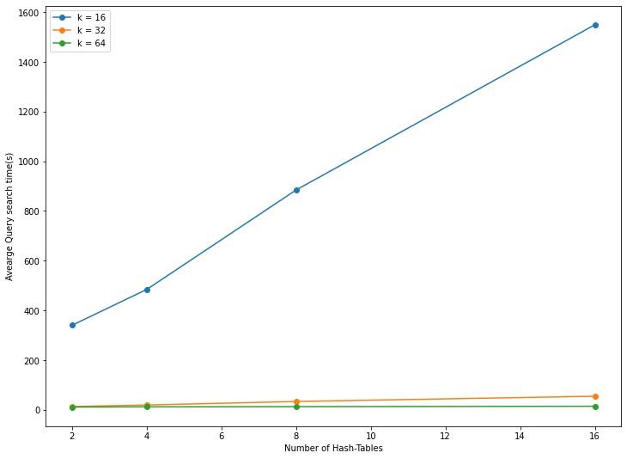
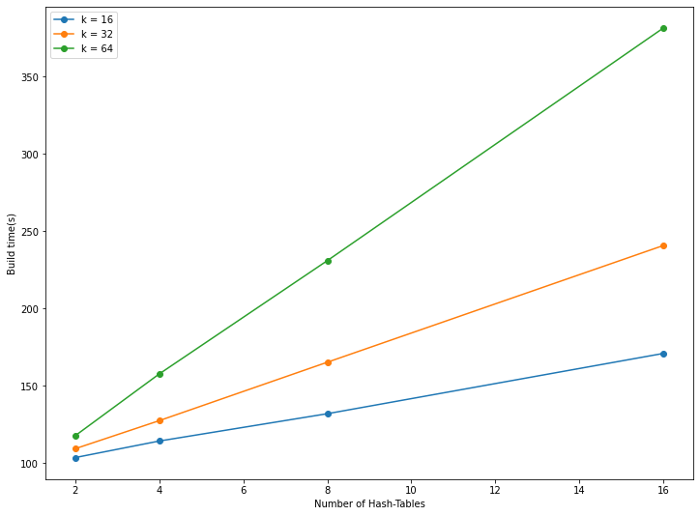
Perturbed Query: Gaussian Noise, sigma = 0.1
No. of Points Searched vs Number of Hash Tables
Build time vs Number of Hash Tables

Slide 16
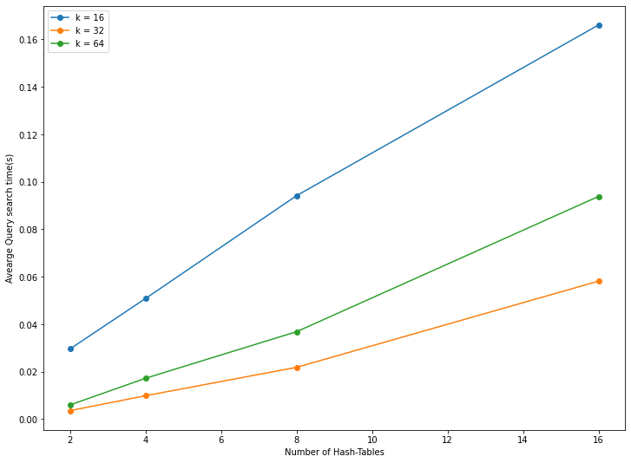
Search time vs Number of Hash Tables
Inferences:
The time graphs and number of points searched vs number of hash tables for perturbed query, follow a same relation as that of exact match query
Accuracy for all cases was 1. Metric used: cosine (a.b <0.05)

Slide 17
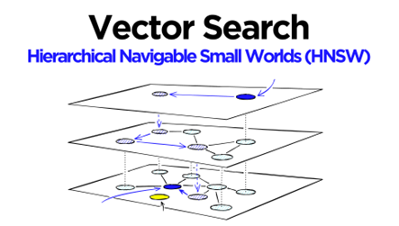
3. Hierarchical Navigable Small Worlds
Uses graph-based structure to perform nearest neighbour search efficiently on large datasets.
The structure is organized into multiple levels, with each level having a smaller number of nodes than the previous level.
When a query is made, HNSW starts at the highest level of the graph and finds the best match, it then proceeds to send the match to the next level until the last layer is reached.

Slide 18
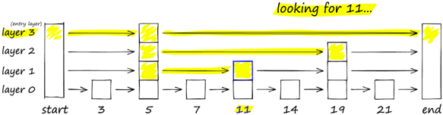
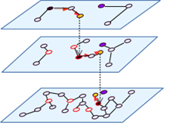

NSW Graphs
PROBABILITY SKIP LIST
Allows fast search like a sorted array, uses linked list structure for fast insertion of new elements.
It works by building several layers of linked lists.
As we move down the layers, number of skips decreases.
Essentially a proximity graph, but has both short-range links as well as long-range links
Each vertex has links with several other vertices, each vertex maintains a connection list
There exist a fixed entry point through which we start our search

Slide 19
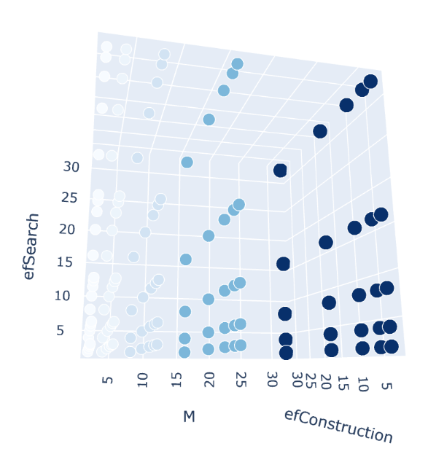
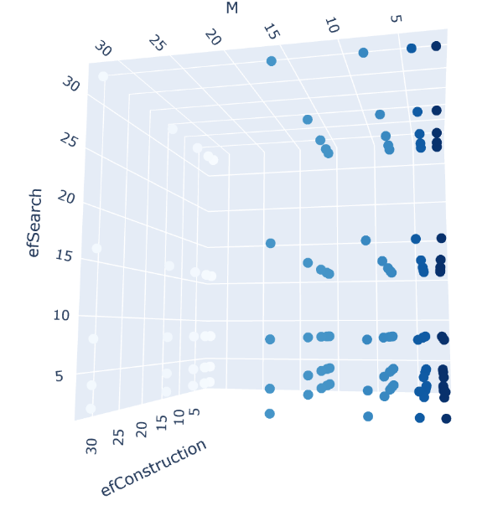
Parameters that affect time/memory
Exact match query
M, efConstruction, efSearch
Memory
Build time vs parameters

Slide 20
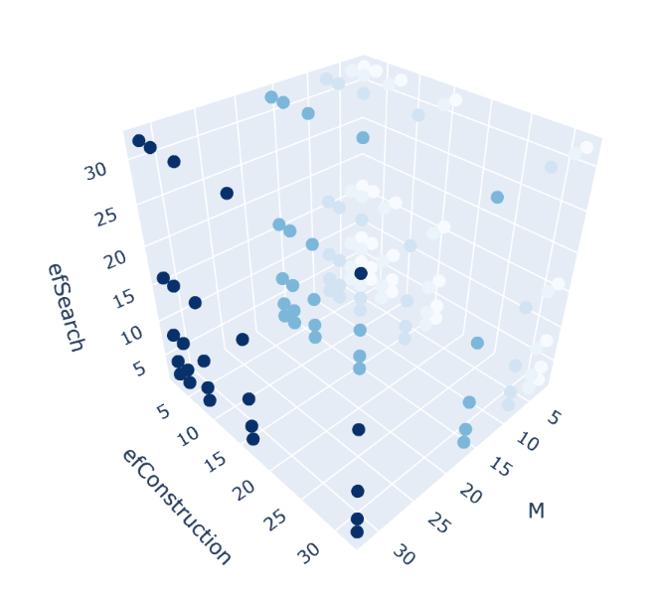
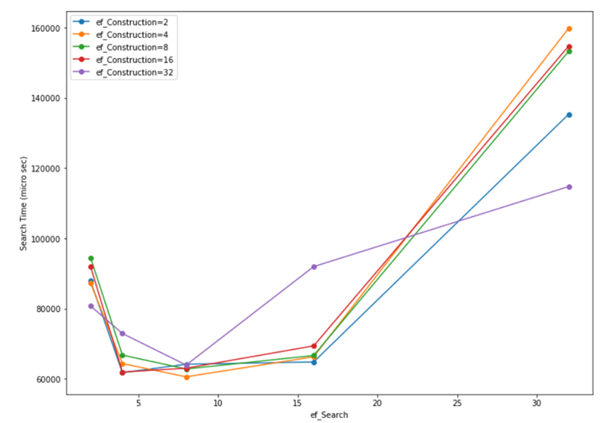
Search Time
Parameter | Recall | Build Time | Search Time | Memory
M ↑ | Increases | Increases | Increases | Increases
efSearch ↑ | Almost same | Almost same | Decreases initially then increases | Almost same
efConstruction ↑ | Almost same: highest for efCon =16 | Initially increases then decreases | Randomized but very close | Almost same

Slide 21
4. ScaNN- Scalable Nearest Neighbours
ScaNN (Scalable Nearest Neighbours) is a state-of-the-art algorithm for approximate nearest neighbour search in high-dimensional spaces.
The algorithm uses a combination of hierarchical clustering and randomized search to efficiently find approximate nearest neighbours.

Slide 22
RANDOMIZED SEARCH
HIERARCHICAL CLUSTERING
The algorithm begins by clustering the data points into a hierarchical structure.
This involves repeatedly dividing the data into smaller clusters until each cluster contains only a few points.
To find the approximate nearest neighbours for a given query point, the algorithm begins at the root of the hierarchical tree and randomly selects a small subset of child nodes to search.
The search is guided by the distances between the query point and the centroids of each child node

Slide 23
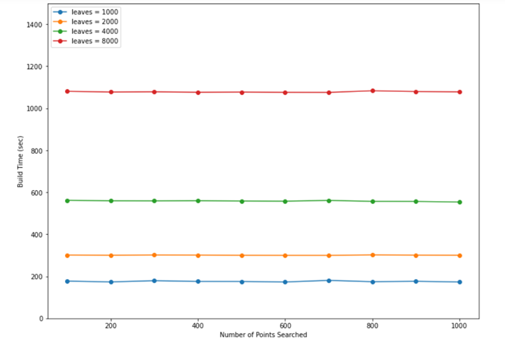
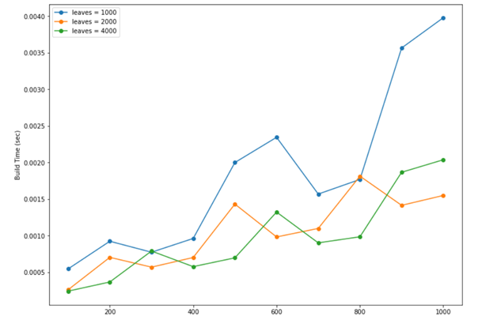
Parameters that affect time/memory
Non-perturbed Query- Exact match
Search
Build time vs Number of points searched
Search time vs Number of points searched

Slide 24
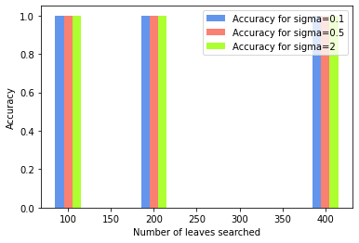
Perturbed Query
For perturbed query: Time graphs are almost similar.
Gaussian Noise: sigma=[0.1, 0.5, 2]
Accuracy of search = 1, for all cases

Slide 25
Comparison & Scalability of different Algorithms
In terms of speed:
Total build time: LSH(30-250s) > ScaNN(200-1000s) > HNSW(70-400s) > PQ(30-100s)
Average Query Search time: ScaNN(0.5-3.5ms) < HNSW(0.08s-0.16s) < LSH(0.1-0.8s) < PQ (4-5s)
Accuracy for exact matches: ScaNN>LSH>HNSW>PQ
Accuracy for perturbed query: ScaNN ~ LSH > HNSW ~ PQ
(For 10000 points)

Slide 26
Results
Future Prospects
ScaNN proves to be the best algorithm for our use.
We can also see that there is a time vs accuracy trade-off for the algorithms.
Although Build time for ScaNN is much higher compared to other algorithms but it’s average query search time is much lower.
Accuracy is also best for both exact matches and perturbed query.
Implement the algorithms for Real audio dataset and analyse the results.

